Slide 1
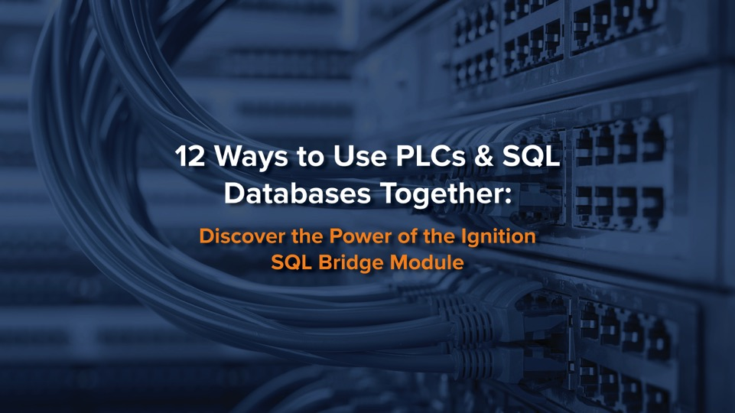

Slide 2
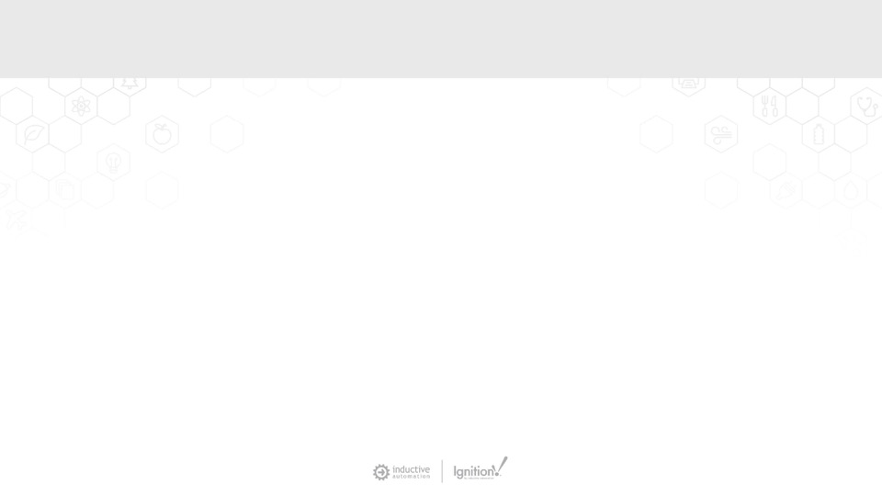

Moderator
Don Pearson
Chief Strategy Officer
Inductive Automation

Slide 3
Today’s Agenda
Introduction to Ignition
The Origin of SQL Bridge
SQL Bridge vs. Tag Historian
12 Use Cases for SQL Bridge
Demo: Recipe Management
Q&A

Slide 4


About Inductive Automation
Founded in 2003
HMI, SCADA, IIoT software used in 100+ countries
Supported by 1,400+ integrators
60% average annual growth rate since 2010
Learn more at: inductiveautomation.com/about

Slide 5
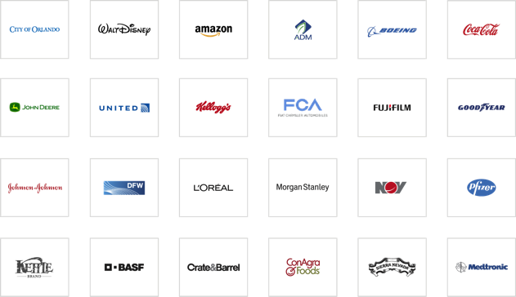


Used By Industries Worldwide

Slide 6



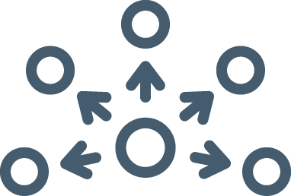


6 Reasons Why Ignition is Unique
Web-Based
Deployment
Unlimited
Licensing
Security
& Stability
Easy
Expandability
Rapid Development
& Deployment
Real-Time Control
& Monitoring

Slide 7


Presenter
Travis Cox
Co-Director of Sales Engineering
Inductive Automation

Slide 8
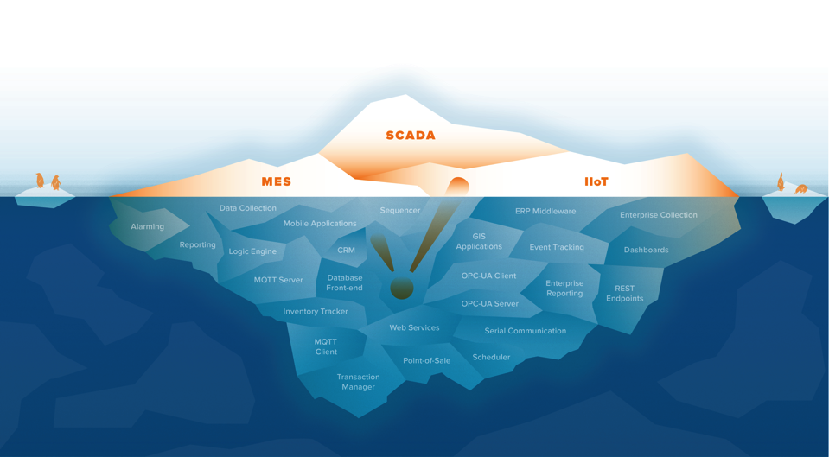
More Than IIoT/SCADA/MES

Slide 9
More Than IIoT/SCADA/MES

Slide 10
The Origin of SQL Bridge
We recognized a need:
  • SQL Bridge Module started out as a product called FactorySQL
  • While working as a control system integrator, our CEO
  Steve Hechtman came up with an idea to move data between
  PLCs and SQL databases using OPC.

Slide 11
The Origin of SQL Bridge
We developed a solution:
  • Steve & his team developed FactorySQL to move data
  between PLCs and SQL databases.
  • Like a “Swiss army knife” for integrators to solve a variety
  of problems
  • Eventually started Inductive Automation, offered FactorySQL
  to other integrators, which is now known as SQL Bridge Module
  and is an essential part of the Ignition platform.

Slide 12
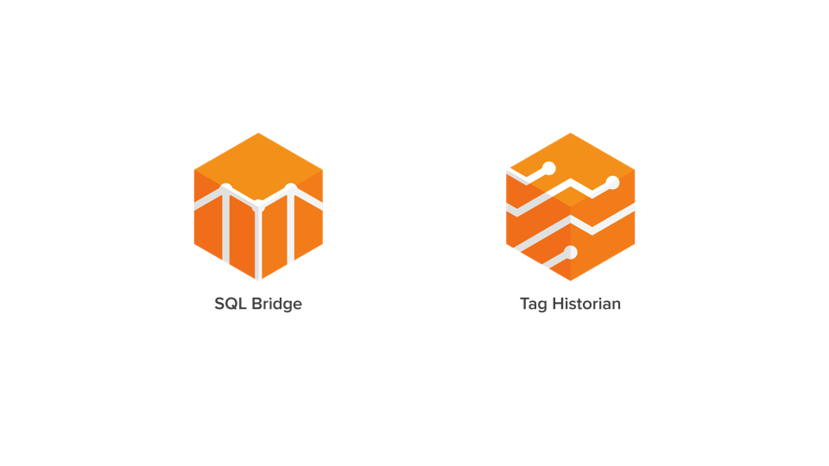
SQL Bridge vs. Tag Historian

Slide 13
SQL Bridge vs. Tag Historian
Tag Historian Module:
• Not in control of the database schema,
data in an open format
• Data is compressed
      • Not very easy to query yourself due to
      partitions and compression
      • Data only logged when the value changes
      • No data context
      • No knowledge of database of SQL
      language necessary
SQL Bridge Module:
• You control the database schema, put
data into any format you choose.
• No compression or data partitioning
• Easy to query yourself
• Groups can log data based on a schedule
and by exception
• Provides contextual data
• More powerful analysis but need to know
SQL language & databases

Slide 14
12 Use Cases for SQL Bridge
  1 History With Context
  2 Synchronize 2 or More PLCs Through a SQL Database
  3 Barcode Scanning
  4 Sequencer
  5 Mapping PLC Values to Database Stored Procedures
  6 Scheduler
  7 Recipe Management
  8 OEE Implementation & OEE Downtime
  9 Production Tracking
  10 Handshaking With PLCs
  11 Putting Real-Time Data and Control with Third-Party Applications
  12 ETL Tools

Slide 15
1. History With Context
  • Tag Historian and SQL Bridge work together to connect
  historical and contextual data
  • PLC event trigger to log contextual data in a SQL database

Slide 16
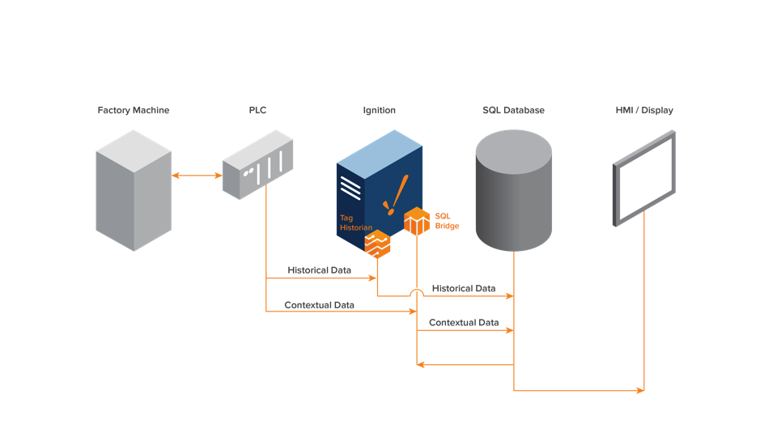
1. History With Context

Slide 17
2. Synchronize 2 or More PLCs Through a SQL Database
  • Keep 2 PLCs identical at all times
  • Change in PLC #1 occurs which updates values in PLC #2 and vice versa
  • Allows communication between different PLC brands and protocols

Slide 18
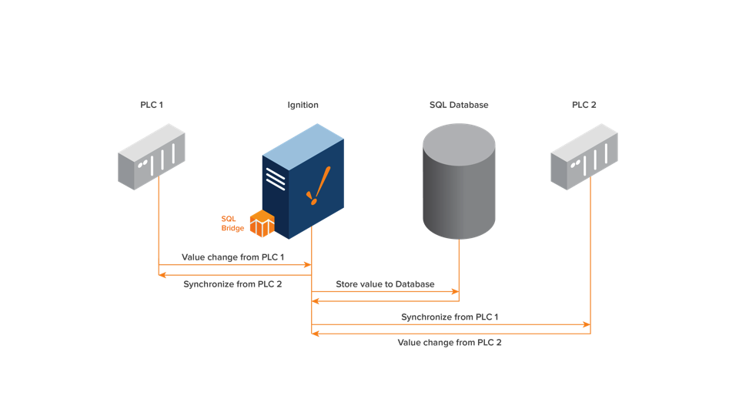
2. Synchronize 2 or More PLCs Through a SQL Database

Slide 19
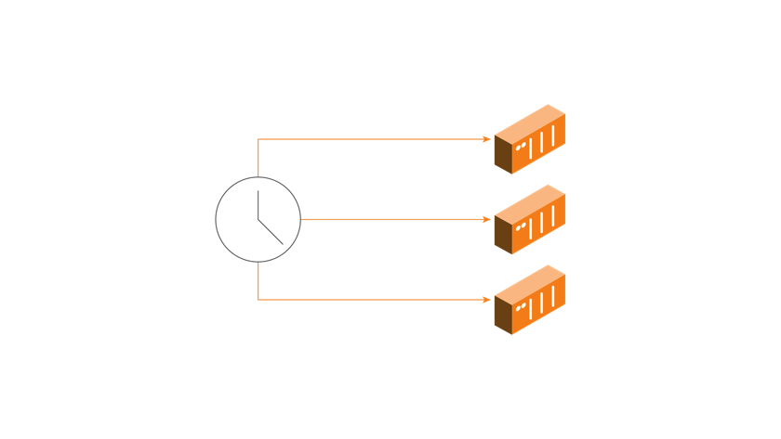
2. Synchronize 2 or More PLCs Through a SQL Database
  • Another way to synchronize: Use Ignition to synchronize
  clocks across all PLCs

Slide 20
3. Barcode Scanning
  • Action is performed based on a barcode scan
  • Barcode is scanned, Ignition will check logic in a SQL database
  • Based on logic, Ignition will send values to a PLC to perform an action

Slide 21
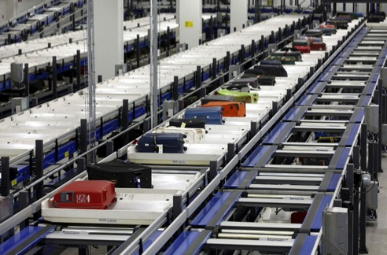
3. Barcode Scanning

Slide 22
4. Sequencer
  • Uses a procedure kept in a SQL database
  • Based on value, location, and other criteria, the procedure
  will send values to the PLC
  • A sequence of events are performed and are logged into
  the database once the operation is complete

Slide 23
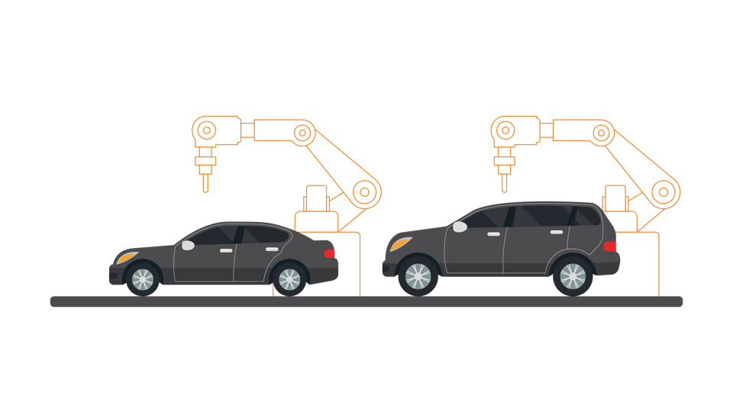
4. Sequencer

Slide 24
5. Mapping PLC Values to Database Stored Procedures
  • Map input/output values
  • To interface with business systems that have a database that
  contains a stored procedure
  • An event happens with a PLC, which is mapped to a stored
  procedure input. Stored procedure sends down values and
  writes them to a PLC.

Slide 25
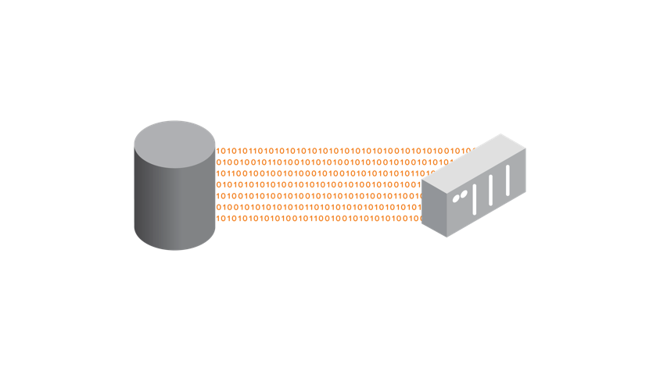
5. Mapping PLC Values to Database Stored Procedures

Slide 26
6. Scheduler
  • Similar to sequencer, but based on time values
  • Control PLCs based on a schedule and outside influences
  • Map values to a PLC at any time

Slide 27
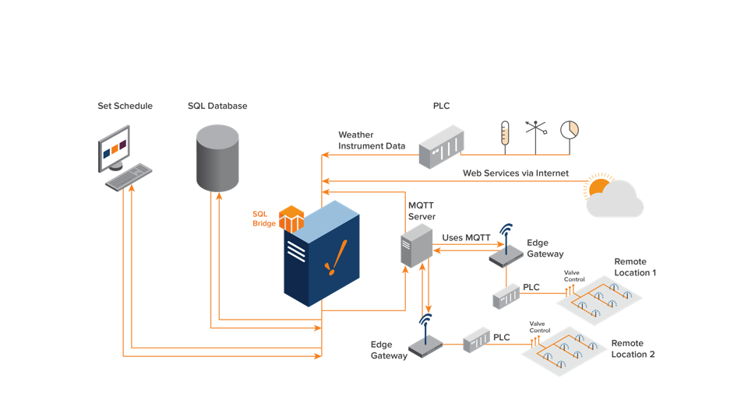
6. Scheduler

Slide 28
7. Recipe Management
  • Recipes should not be stored on a PLC. Store recipes in a
  database instead.
  • When a recipe load is triggered, Ignition will take the recipe
  from the database and load it to the PLC.
  • SQL database allows for greater flexibility to store more
  recipes, lets the PLC focus on control.

Slide 29
8. OEE Implementation & OEE Downtime
  • Check the downtime and efficiency of production lines
  • Simple to perform OEE calculations and have information
  logged to a database.
  • Get notifications on downtime and uptimes along with
  contextual data.

Slide 30
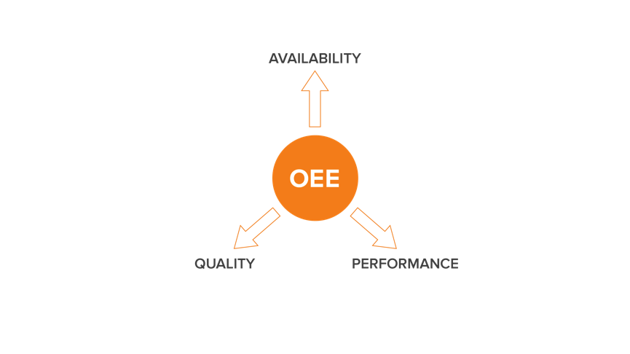
8. OEE Implementation & OEE Downtime

Slide 31
9. Production Tracking
  • Know which products have moved through which machines
  • In addition to OEE downtime, collect data for traceability such
  as the amount of product being produced, associated work
  orders, lot numbers.
  • Create a custom MES system for a very low cost.

Slide 32

9. Production Tracking

Slide 33
10. Handshaking with PLCs
  • Simple handshake with the PLC, so the PLC and SCADA
  systems are synchronized.
  • Allows Ignition to notify a PLC if a process has been completed
  and whether or not it was a success or failure.

Slide 34
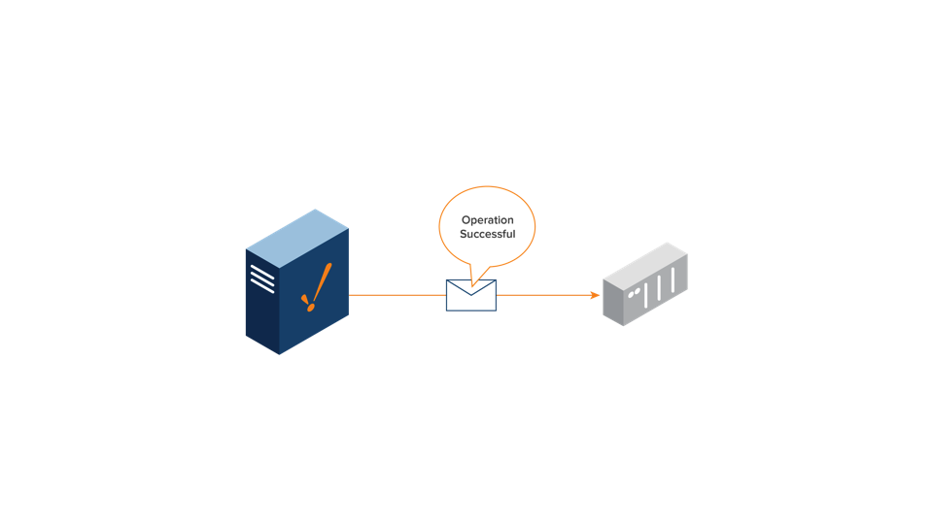
10. Handshaking with PLCs

Slide 35
11. Putting Real-Time Data and Control with Third-Party Apps
  • Use open-standard SQL databases to store real-time information
  • Third-party applications can access data from databases instead of PLCs
  • Bidirectional functionality of SQL databases allow control values to be
  sent to PLCs from third-party apps.
  • Direction of data can be unidirectional or bidirectional

Slide 36
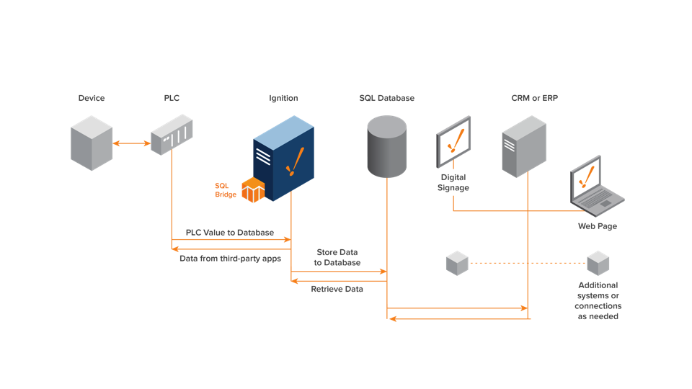
11. Putting Real-Time Data and Control with Third-Party Apps

Slide 37
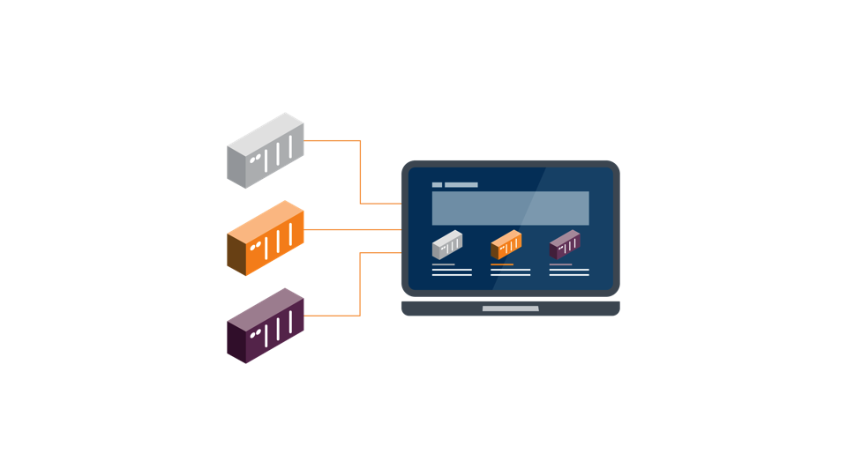
11. Putting Real-Time Data and Control with Third-Party Apps

Slide 38
12. ETL (Extract, Transfer, Load) Tool
  • Used in data warehousing
  • Collect data from different systems, parse it, put into database,
  and potentially load values to PLC
  • Use a stored procedure to perform this function
  • Make logic simpler in Ignition, use less scripting

Slide 39
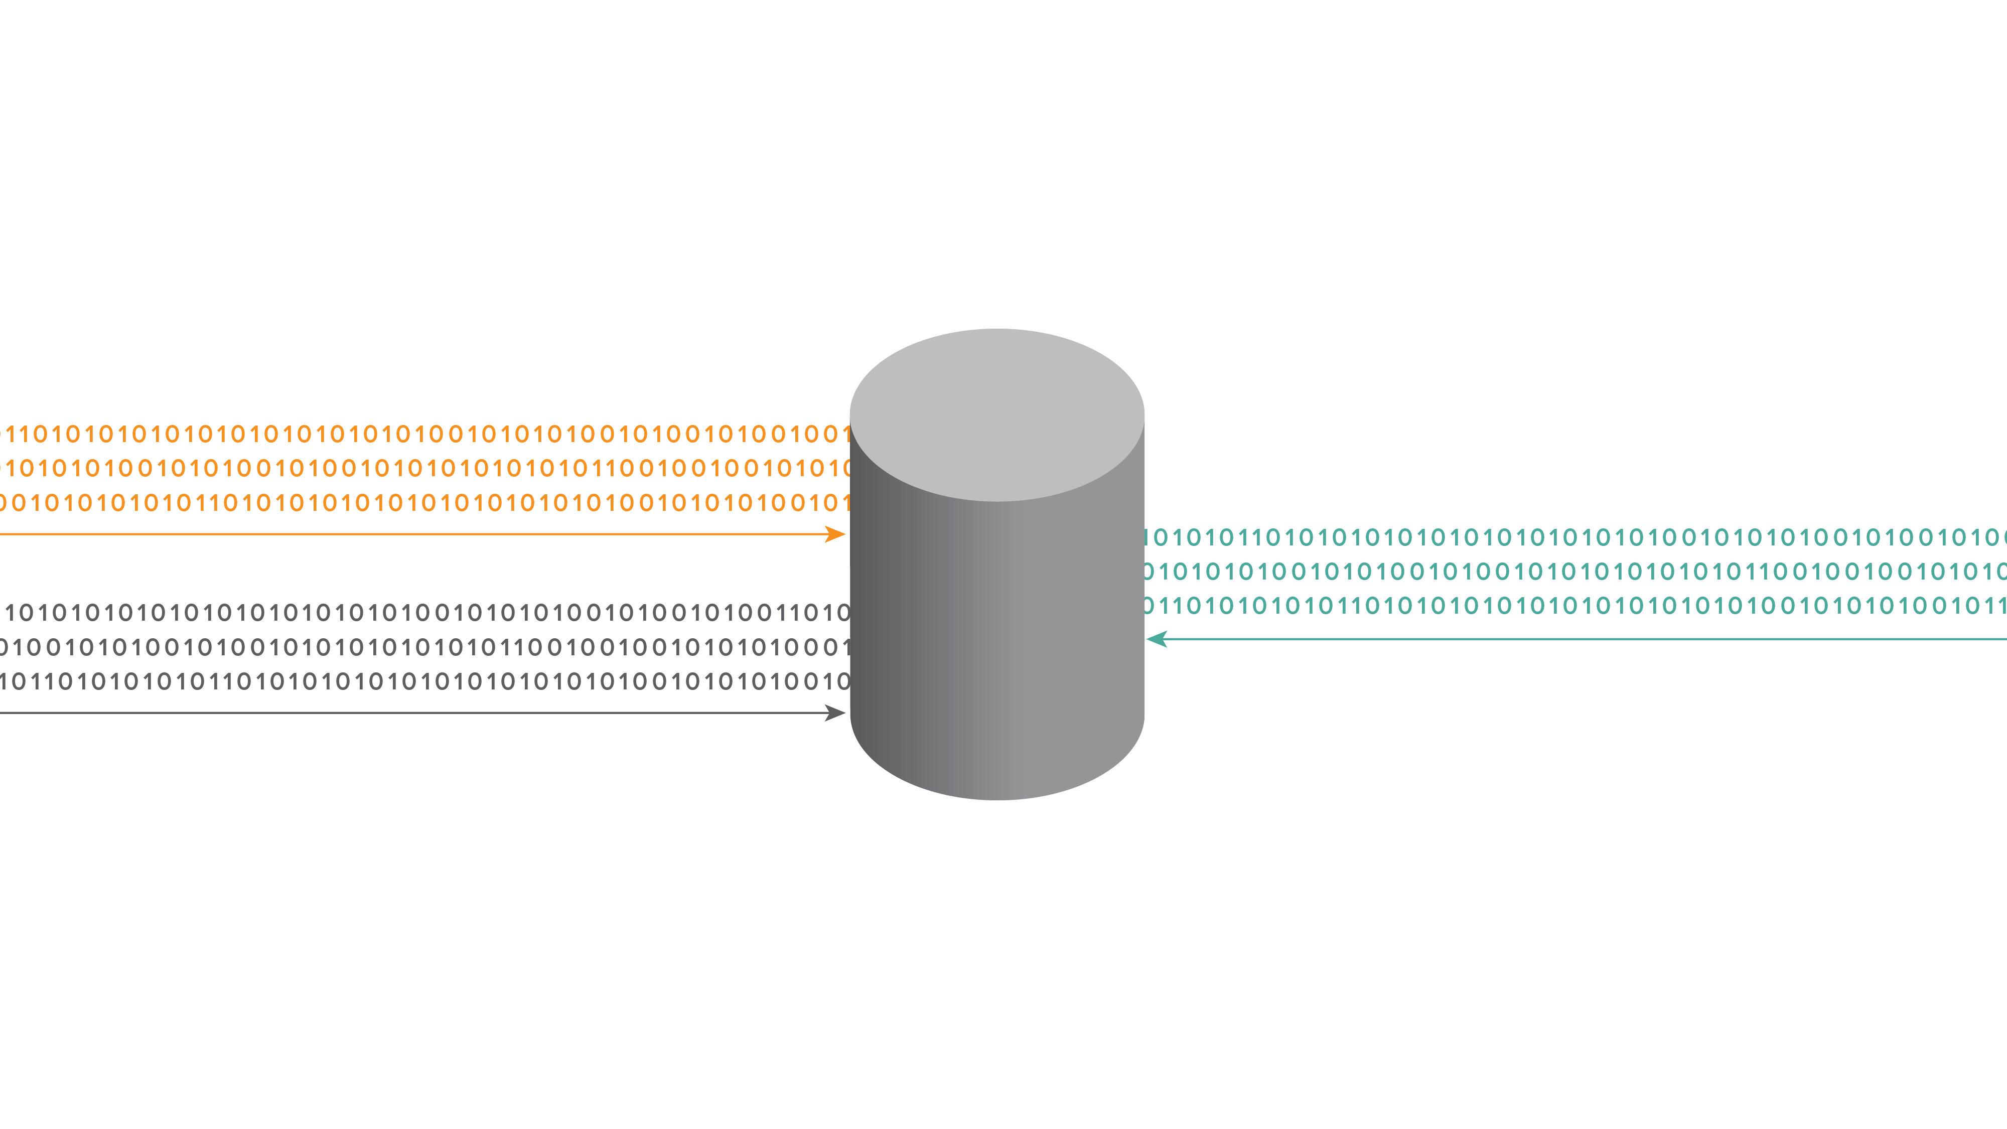
12. ETL (Extract, Transfer, Load) Tool

Slide 40
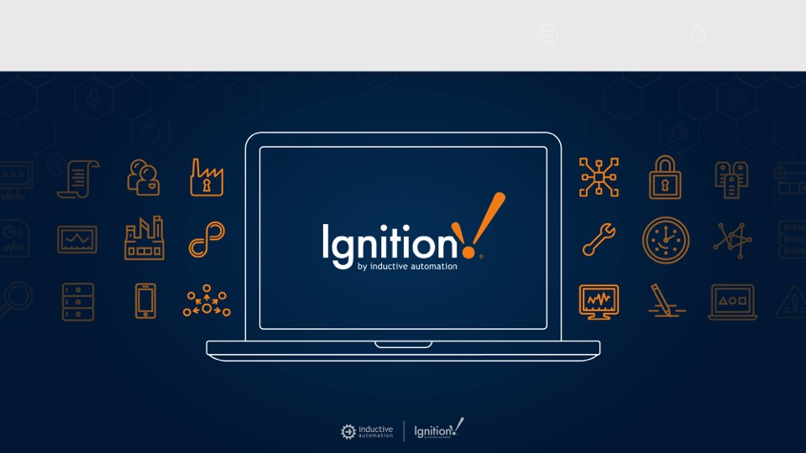
Ignition Demo: Recipe Management

Slide 41

Discover the SQL Bridge Module
SQL Bridge Module
Incredible power and versatility at a very low price
bit.ly/sql-bridge

Slide 42
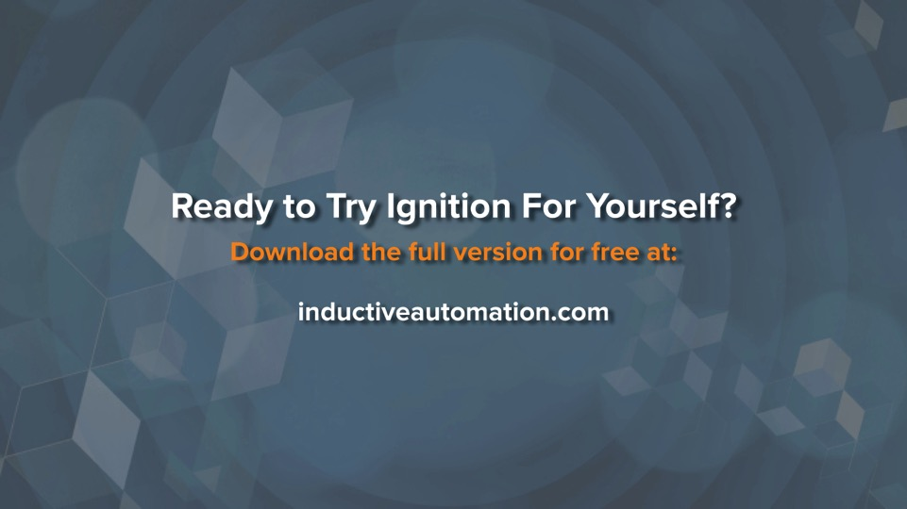

Slide 43


Slide 44

Questions & Comments
Melanie Moniz
Director of Sales:
Travis Cox
Presenter:
800-266-7798 x229
travis@inductiveautomation.com
800-266-7798 x247
Account Executives
Jim Meisler x227
Myron Hoertling x224
Maria Chinappi x264
Vannessa Garcia x231
Melanie Moniz x247
Dan Domerofski x273
Vivian Mudge x253
Shane Miller x218
Lester Ares x214
Ramin Rofagha x251

Slide 45


